Slide 1
TITAN 2.0 Crash
Lt William Head and Sgt Michael Lowe
TITAN/IBM Team
Notes:
This powerpoint shows the basics of how to start, fill, and submit a TITAN 2.0 crash report.

Slide 2
TITAN 2.0 Crash on the Web
Site is titan.safety.tn.gov
Available on any device with active internet service
Use an up-to-date browser: Chrome, Firefox, Edge, Safari, etc…
NOT available for offline use.
Username, Password, and profile are mirrored from TITAN Client
Any crashes/reports created in TITAN Client are not editable in TITAN 2.0
Notes:
Must have an active internet provider to access the site.
Site is titan.safety.tn.gov
The username and password are the same from the TITAN Client or TITAN Portal
Reports created in the TITAN Client are not editable in TITAN 2.0 and vice versa

Slide 3
3 Levels of Collection
Level 1…..Property Damage only and combined value is Less Than Thresholds. Approx. 1/3 of report questions
Level 2…..Property damage only and combined value is More Than Thresholds. Approx. 2/3 of report questions
Level 3…..Injuries or fatalities involved. Includes Alcohol/Drugs, Arrestable Offenses, Towed Vehicle, or Medical Transport. All report questions
Note: The levels of reporting are automatically adjusted by the program from the entries on the Crash Level page.
Notes:
The pdf image will display in the top left corner as to what level the report is.

Slide 4
Login
TITAN 2.0 is available at titan.safety.tn.gov
Click the TITAN 2.0 then Sign In
Notes:
The sign-in page is the same but takes you to an alternate site for TITAN 2.0

Slide 5
Create Report
QUICK START A CRASH REPORT…
Landing page after login. Press the orange collision button in the lower part of the navigation bar on the left.
Modules>Crash> + New Crash will also start a new report
Notes:
Clicking the orange icon at the bottom left will start the initial page of the crash report.
Also clicking Modules> Crash> + New Crash will start the initial page of the crash report

Slide 6
Crash Level
Minimum 3 Fields to Start/Save a new report.
This page collects the minimum 3 questions to Save/Start a crash. (Crash Type, School Bus Involvement, and Agency Tracking #)
Notes:
Fill in Crash Type, School Bus Involved, Agency Tracking # then click Save or Next to start a report.

Slide 7
Save & Navigate
Once the minimum three fields have been collected and saved, you can navigate to any stepper of the report.
The exclusion to this is the Table of Measures, which must be chosen as Yes on Crash Level (page shown in slide).
Notes:
Once you have an “MRN” visible, you have started a report and can move to any section.
The Table of Measures section will be grayed out until the slide button is moved to YES

Slide 8
Action Buttons
At the bottom of the pages there are four buttons that may appear:
Previous- takes you to the previous page.
Next- takes you to the next page.
Save- saves the information entered.
Validate- this button will show the validations only for the current page.
The Attachments section has the Validate All which checks the complete report for errors.
Notes:
The Validate button can be used on each individual page. It gives the validation errors as a guide. You can fix the errors as you go or wait until the end of the report with the Validate All.

Slide 9
Quick Capture
Scan Box accepts scanned barcode data from a DL or Registration using a COMPATIBLE DEVICE set to “Keyboard mode”
This tab becomes available after the minimum three collection criteria. This box collects only scanned barcodes from DL’s and Registrations. Mobile devices may have an app to accept a scanned image. Computers may have external hardware for scanning. The input for this can only be “keyboard mode” settings.
Notes:
This Quick Capture tab is grayed out until the minimum three items are entered and Saved. This box is available to a scan function in “keyboard mode” only. Vehicle and person cards are added to this page. The cards must then be used or deleted before the crash report can be submitted.
A vehicle must be added to the Unit section prior to adding an Occupant

Slide 10
Crash Interview
This page collects general information about the crash. Such as; number of vehicles and persons, investigator details, location of crash, work zone information, and secondary incident information, and any lane closures.
Scroll down the screen….
Notes:
Fill in the number of motor vehicle(s) involved and the number of Occupant(s) in, or on, the motor vehicle(s)
Fill in the number of Property owners involved in the crash
Fill in the number of Witnesses for the crash

Slide 11
Crash Interview
Investigator details: some of this information is from your profile and some can be edited.
Assisting Officer details can be added here.
Scroll down the screen….
Notes:
The investigating officer is defaulted information from your profile.
The assisting officer info must be manually entered

Slide 12
Mapit
Select the Trafficway Type and the This popout module collects the location of the crash.
Notes:
Trafficway Type must be selected for the Map-It button to be available
Click on the Map-It button to get the popout

Slide 13
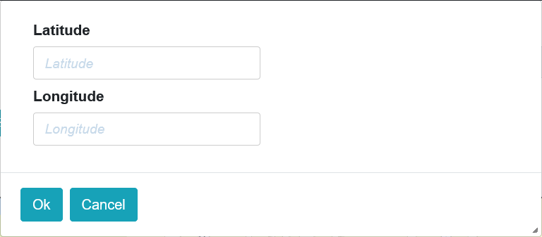
Map-It Options
1150 Foster Ave
Enter Lat/Long coordinates,
OR
Click on the map,
OR
Search for an address,
Then
Submit the selection.
Not Found when the new street or address cannot be located. You will have to manually enter the location details.
Notes:
The Lat Long must be in Degrees.decimal format. Example Latitude 36.13505, and Longitude -86.740366 (Click OK then Submit)
The negative sign must be added at the beginning of the Longitude.
Click on the map where the crash occurred. Allow a few seconds to gather the information, (then click Submit).
For the address search, start typing the number and street of the address. A list will populate and choose which one is pertinent. (then click Submit)
If the address or location cannot be found, click the Not Found button and manually enter the location information

Slide 14
Crash Interview
Most of the Location and Reference/Cross Street information will come from the Map-it module. Work Zone information and Railroad crossing ID is collected.
Scroll down the screen….
Notes:
Finish filling the information not populated by the Map-It popout

Slide 15
Crash Interview
Secondary Incident information:
Did a previous traffic situation occur that may be connected to this crash? Congestion, debris in roadway, maintenance work, etc…
Roads or Lanes Blocked:
Which lanes were closed and for how long?
Note: These two questions are independent of each other.
Notes:
Was this crash involving a previous incident such as Debris in Roadway or Construction Zone?
Were there any lanes blocked? Which lanes and for how long?

Slide 16
Add A Vehicle
This page collects vehicle information involved in the crash. Once a vehicle is added, the driver, owner, or passengers can then be added.
Scroll down the screen….
Notes:
Click the +Add Unit button to add a motor vehicle to the crash.
A vehicle must be added prior to adding an occupant.

Slide 17
Vehicle Details
This page collects vehicle information involved in the crash. Once a vehicle is added, the driver, owner, or passengers can then be added. The scan box will also accept a TN Tag# and check it with TN Dept of Revenue vehicle registration database. The plate expiration can be “PERM” for non-expiring.
Scroll down the screen….
Notes:
A TN tag can be manually entered into the Tag Scan box and click OK. The tag will be referenced from the TN Dept of Revenue and displayed in the fields.
The Tag Scan box will also collect scanned data from a certificate of registration(works with more than just TN registrations)

Slide 18
Vehicle Details
This page collects vehicle information involved in the crash. Once a vehicle is added, the driver, owner, or passengers can then be added.
Scroll down the screen….

Slide 19
Trailer Detail
If you chose a Trailer for this vehicle is yes, this Trailer Details section opens for you to enter details. The plate expiration can also be “PERM” for non-expiring
Notes:
The trailer detail is only visible if the trailer is selected as Yes
The tag expiration can be “PERM”

Slide 20
Add A Person
This page collects vehicle information involved in the crash. Once a vehicle is added, click the Add Person block to add the driver, owner, or passengers.
Scroll down the screen….
Notes:
Once a Unit is added, you can add a driver, owner, or passengers by clicking Add Person
A Unit can be Edited or Deleted
A Person can be Edited or Deleted

Slide 21
Occupant Detail
This page collects the detail of the driver, passenger, or owner of the vehicle. The scan box will also accept a TN Driver license# and check it with TN Dept of Safety driver license database.
Scroll down the screen….
Notes:
A TN DL can be manually entered into the DL Scan box and click OK. The tag will be referenced from Dept of Revenue and displayed in the fields.
The DL Scan box will also collect scanned data from a driver license barcode(works with more than just TN DL’s)

Slide 22
Occupant Detail
This page collects the detail of the driver, passenger, or owner of the vehicle. The Driver’s License # cannot be blank. If the person has never had a number assigned, “NONE” must be used.
Any “Pending” test results flag this report for the Dashboard Pending tab.
Scroll down the screen….
Notes:
“Pending” results will cause the report to show in the Dashboard in the Pending Alc/Drug tab. This is strictly for ease of finding and updating the pending reports

Slide 23
Occupant Detail
If you choose Violations as Yes for this person, the violation entry will be available to document the violation details.

Slide 24
Non-Occupant
This page collects non-occupant persons involved in the crash. Click the Add Person block to add non-occupants, witnesses, or property owners.
Scroll down the screen….

Slide 25
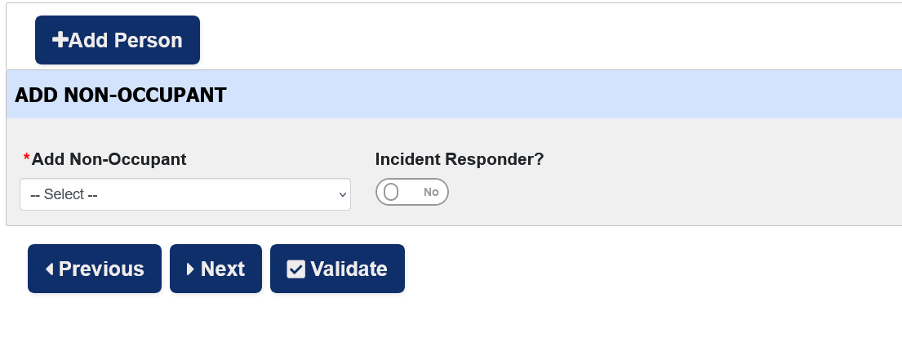
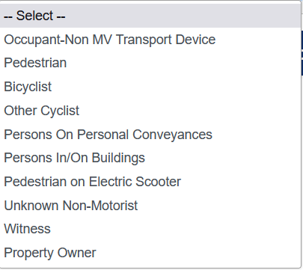
Non-Occupant type
Select the type of non-occupant you would like to add.
Scroll down the screen….

Slide 26
Non-Occupant Detail
This detail page is for the selection of a non-motorist other than a witness or property owner. The scan box will also accept a TN Driver license# and check it with TN Dept of Safety driver license database.
Scroll down the screen….
Notes:
Depending on the type of non-occupant you choose, different collection fields may appear

Slide 27
Non-Occupant Detail
This detail page is for the selection of a non-motorist other than a witness or property owner.
Any “Pending” test results flag this report for the Dashboard Pending tab.
Notes:
“Pending” results will cause the report to show in the Dashboard in the Pending Alc/Drug tab. This is strictly for ease of finding and updating the pending reports

Slide 28
Non-Occupant Witness
This detail page is for the selection of a witness. The scan box will also accept a TN Driver license# and check it with TN Dept of Safety driver license database.
Notes:
Witnesses should write their statements to be added as an attachment.

Slide 29
Non-Occupant Property Owner
This detail page is for the selection of a property owner. The scan box will also accept a TN Driver license# and check it with TN Dept of Safety driver license database.
Property Owners should be given a Unit driver’s name and license information. Otherwise, they cannot obtain a report from PurchaseTNCrash.gov
Notes:
A property owner should be given the name and driver license number of a motor vehicle driver involved in the crash. Persons with property damaged in the crash have statutory rights to information of the crash.

Slide 30
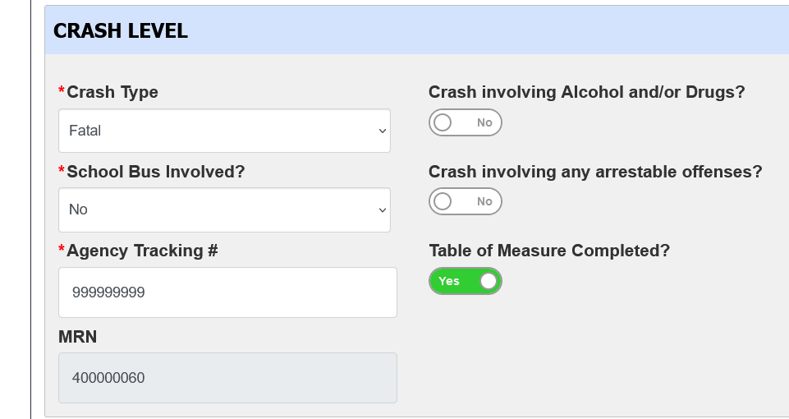
Table of Measures
Select the type of measurement(s) you wish to document. Multiple selections are allowed.
This optional Table of Measures only appears if the slide button in the Crash Level is selected YES
Scroll down the screen….

Slide 31
Table of Measures
Only the wanted sections will appear on the page.

Slide 32
Attachments & Narrative
Type factual narrative here.
This page collects the factual narrative of the investigating officer, files and documents on the machine, and the crash diagram.
Notes:
This narrative is for factual information of the crash. If the parties involved would like to make a statement. They should write write it in their own words to be added as an attachment.

Slide 33
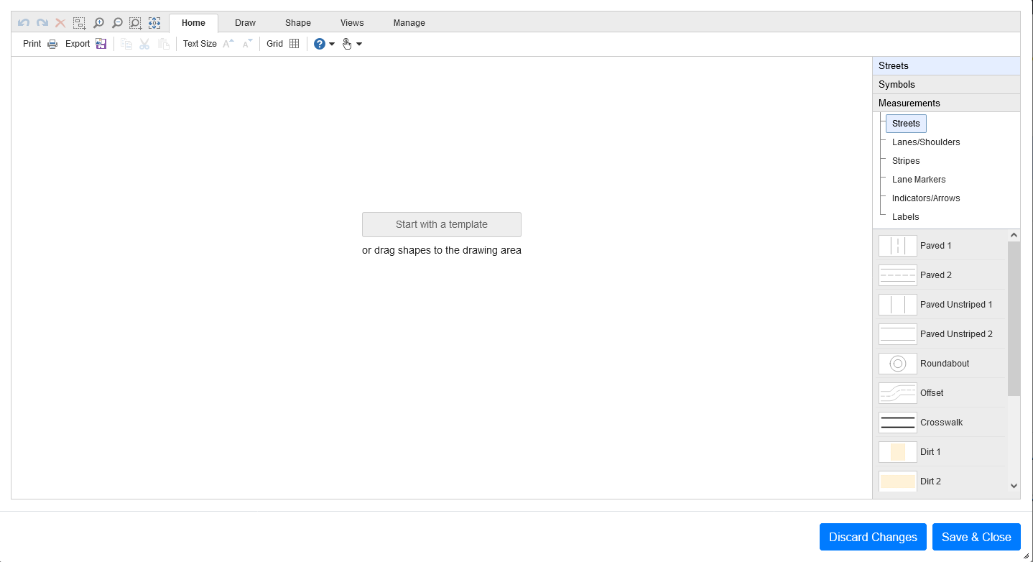
Crash Diagram
This page collects the factual narrative of the investigating officer, files and documents on the machine, and the crash diagram.
Notes:
The diagrams can be saved as templates.
Older ESD templates can still be used if they are stored on the same machine at the time of the diagramming.

Slide 34
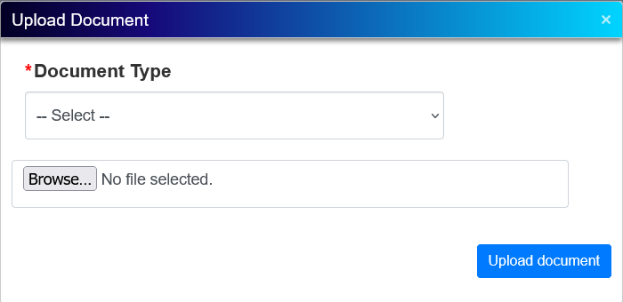
Add Local Files
This page collects the factual narrative of the investigating officer, files and documents on the machine, and the crash diagram. Photos should not be attached to the report.
Notes:
Add files such as witness statements, supplemental narratives, toxicology reports, or medical examiner reports.
Attachments are limited to 1.6 MB per attachment and 6 MB total.
Photos should NOT be attached to the report.

Slide 35
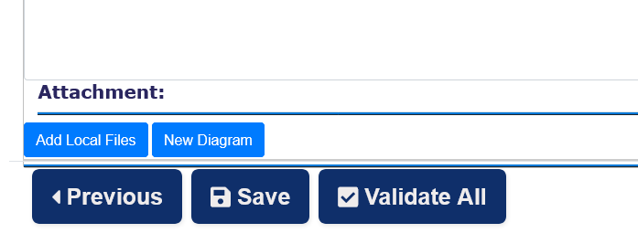
Attachment Cards
Once added, the Diagram and attached documents are individually shown as information cards.

Slide 36
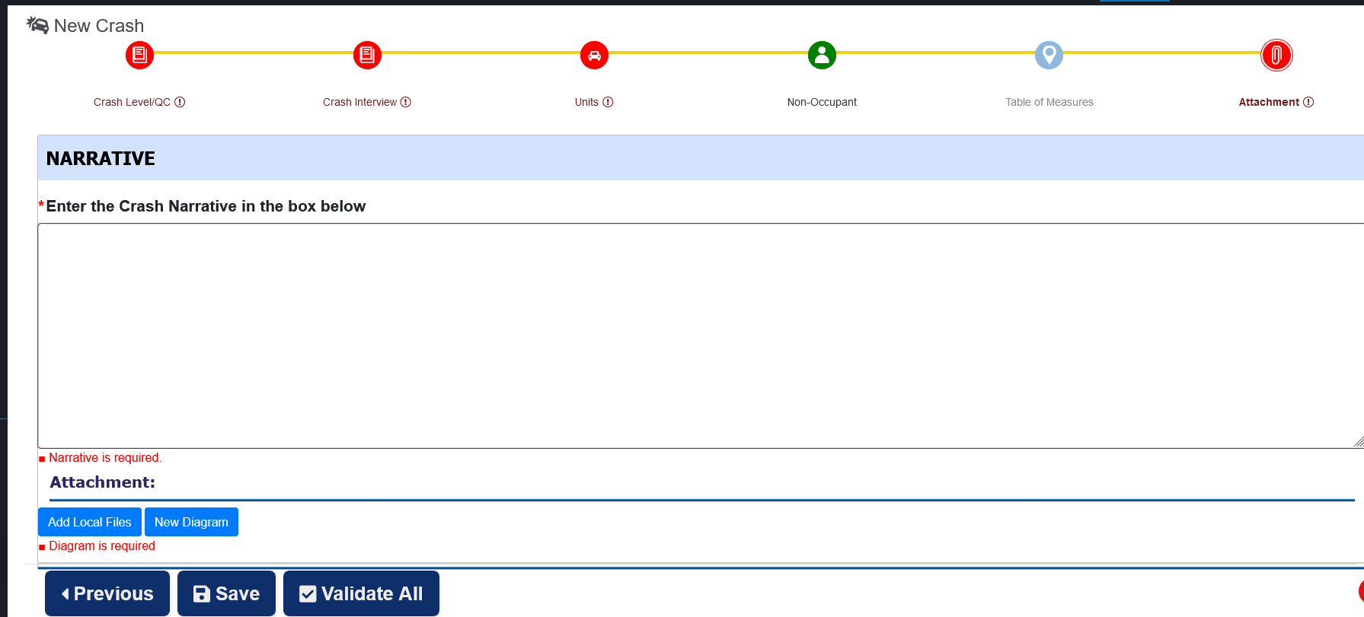
Validate All
Validate All scans every entry and section for validation errors.
If validation errors are found through the complete report, the sections with the errors will show in red. Click on the sections to see the detail errors or missing information.
The sections without validation errors will show as green. All active sections be green to Submit the report.

Slide 37
Validate All
Validate All scans every entry for validation errors. If no validation errors are found through the complete report, the View Report and Submit buttons will become available.
If they do not appear, you still have validation errors in the report. Review the red tabs and correct any needed information.

Slide 38
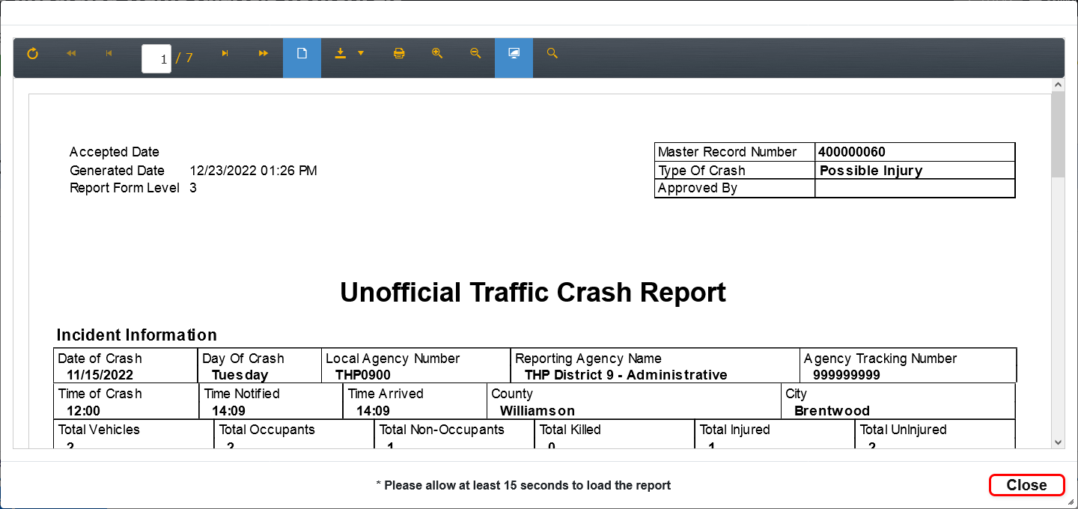
View Report
NOTE: This is an unofficial report image and is only available immediately following the successful Validate All. If you move to a different part of the report or edit any page, the View Report and Submit disappears and the Validate All will have to be processed again.
You can view and/or save the report.

Slide 39
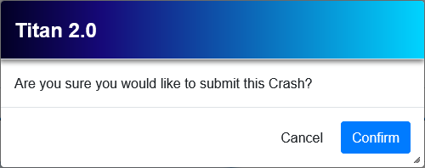
Submit Report
NOTE: The Submit button is only available immediately following the successful Validate All. If you move to a different part of the report or edit any page, the Submit button disappears and the Validate All will have to be pressed again.

Slide 40
Accept Pending
After the Submit confirmation, the report will now show in your Dashboard>Inbox as Accept Pending

Slide 41
Questions?
TITAN 2.0 Crash
Lt William Head william.head@tn.gov
Sgt Michael Lowe michael.lowe@tn.gov
TITAN Help Desk titan.safety@tn.gov

